Slide 1
DECISION TABLE AND TRACEABILITY MATRIX
BY
ALANDI KADAM-19013

Slide 2
DECISION TABLE
A Decision Table is a structured way to represent and analyze complex decision-making processes, particularly when multiple conditions or rules influence an outcome. It helps in identifying all possible combinations of conditions and corresponding actions that should be taken based on those conditions.

Slide 3
KEY COMPONENTS OF DECISION TABLE
Conditions (Input variables): These are the rules or criteria that need to be checked. They describe different situations or inputs.
Actions (Outputs): These are what you do based on the conditions. They show the outcomes or decisions that result from the conditions.
Rules: Rules are combinations of conditions and the actions that should be taken when those conditions are true.
Condition Entries: The condition entry shows whether each condition is met (usually represented as "Yes", "No", "True", "False", or numeric values). This helps clarify the input state for each rule.EG: Yes/No, True/False.
Action Entries: These specify the actions to be taken for each rule, indicating what should happen when the conditions are in a certain state.

Slide 4
TYPES OF DECISION TABLE
Limited-Entry Table: This type of table has only "Yes" or "No" (or "True" or "False") values for each condition. It’s simple and binary.
Extended-Entry Table: Here, conditions and actions may have more than just two possible values (e.g., different numbers, multiple outcomes).
Incompletely Specified Table: Some conditions or actions might not apply in every rule, so certain cells can be left blank.

Slide 5
EXAMPLE - FOR LOGIN SYSTEM
CONDITION | Rule 1 | Rule 2 | Rule 3 | Rule 4
Username is correct | Yes | Yes | No | No
Password is correct | Yes | No | Yes | No
ACTIONS
Allow login | Yes | No | No | No
Display "Incorrect password" | No | Yes | No | Yes
Display "Incorrect Username" | No | No | Yes | Yes

Slide 6
MY PROJECT
Condition | Rule 1 | Rule 2 | Rule 3 | Rule 4
User is registered | Yes | Yes | No | Yes
User logs in successfully | Yes | No | - | Yes
User gives email inbox access | Yes | Yes | - | No
Spam is detected in inbox | Yes | No | - | Yes
Actions
Move spam to trash | Move spam | No spam found | Register/Login | Access Denied
Send notification | Send notification | No spam found | Register/Login | Access Denied
User can delete messages from trash | Yes | Yes | - | No

Slide 7
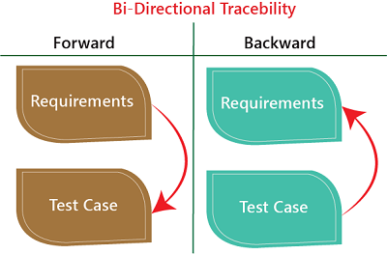
TRACEABILITY MATRIX
It is a simple table that helps you track whether all your project’s requirements have been tested properly. It shows the connection between what needs to be done (requirements) and how you’re going to check if it works (test cases).
TYPES OF TRACEABILITY MATRIX
Forward traceability
Backward or reverse traceability
Bi-directional traceability

Slide 8
Example - Login System
Requirement ID | Requirement Description | Tese case ID | Test Case Description | Status
R1 | The system should allow users to input an email and password. | T1 | Verify the user can input an email and password correctly. | Covered
R2 | The system should validate the email and password combination. | T2 | Validate that the system checks for valid email and password. | Covered
R3 | The system should display an error message for invalid input. | T3 | Check that an error message is shown for wrong credentials. | Covered
R4 | The system should redirect the user to the home page upon login. | T4 | Ensure the user is redirected to the home page after login. | Covered

Slide 9
MY PROJECT
Requirement ID | Description | Test Case ID | Status
RQ1 | The application should allow users to register and log in. | TC1 | Pass
RQ2 | The user should grant access to their email inbox. | TC2 | Pass
RQ3 | The system should detect spam emails in the user's inbox using machine learning. | TC3 | Pass
RQ4 | The detected spam emails should be moved to a "Trash" folder. | TC4 | Pass
RQ5 | The user should receive a notification when a spam email is detected. | TC5 | Pass
RQ6 | The user should have the ability to delete all spam emails from the "Trash" folder. | TC6 | Pass
RQ7 | If no spam is detected, no messages should be moved or deleted. | TC7 | Pass
RQ8 | Access should be denied if the user does not grant access to their email inbox. | TC8 | Pass
RQ9 | The application should notify the user if they are not registered or logged in properly. | TC9 | Pass

Slide 10
THANK YOU !

Slide 11
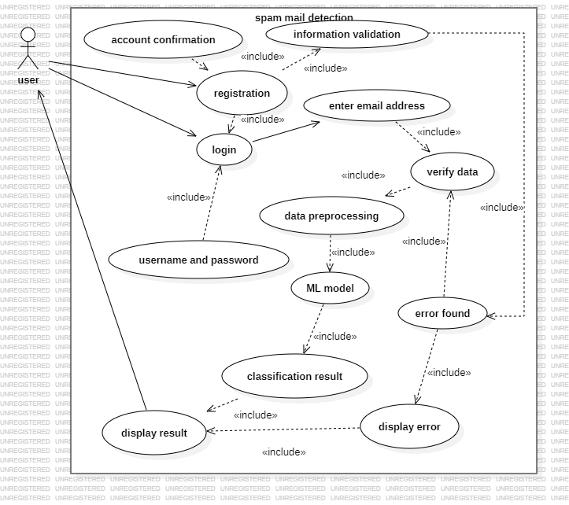
USE CASE DIAGRAM

Slide 12
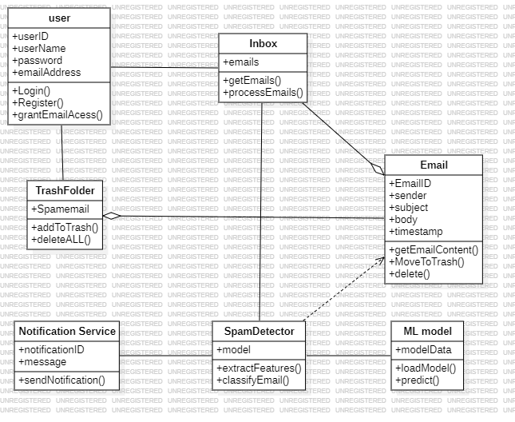
CLASS DIAGRAM

Slide 13
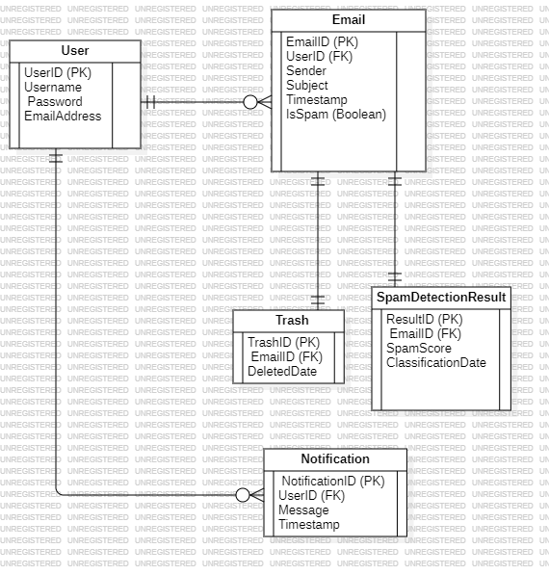
ER DIAGRAM

Slide 14
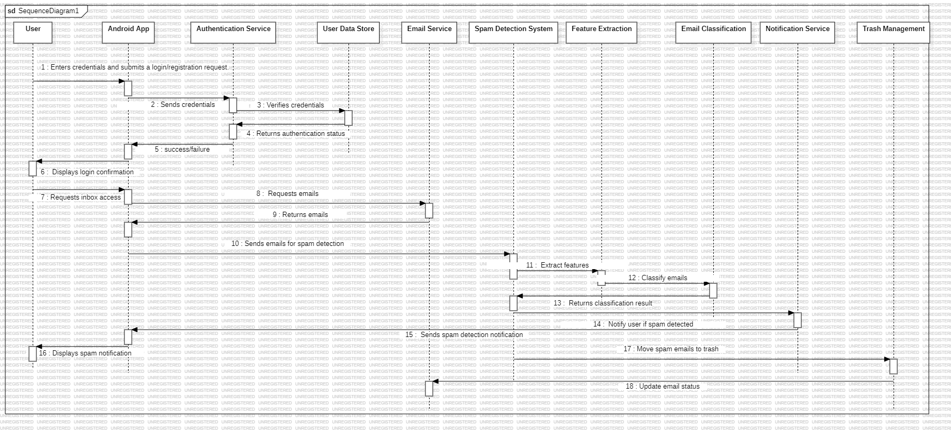
SEQUENCE DIAGRAM

Slide 15
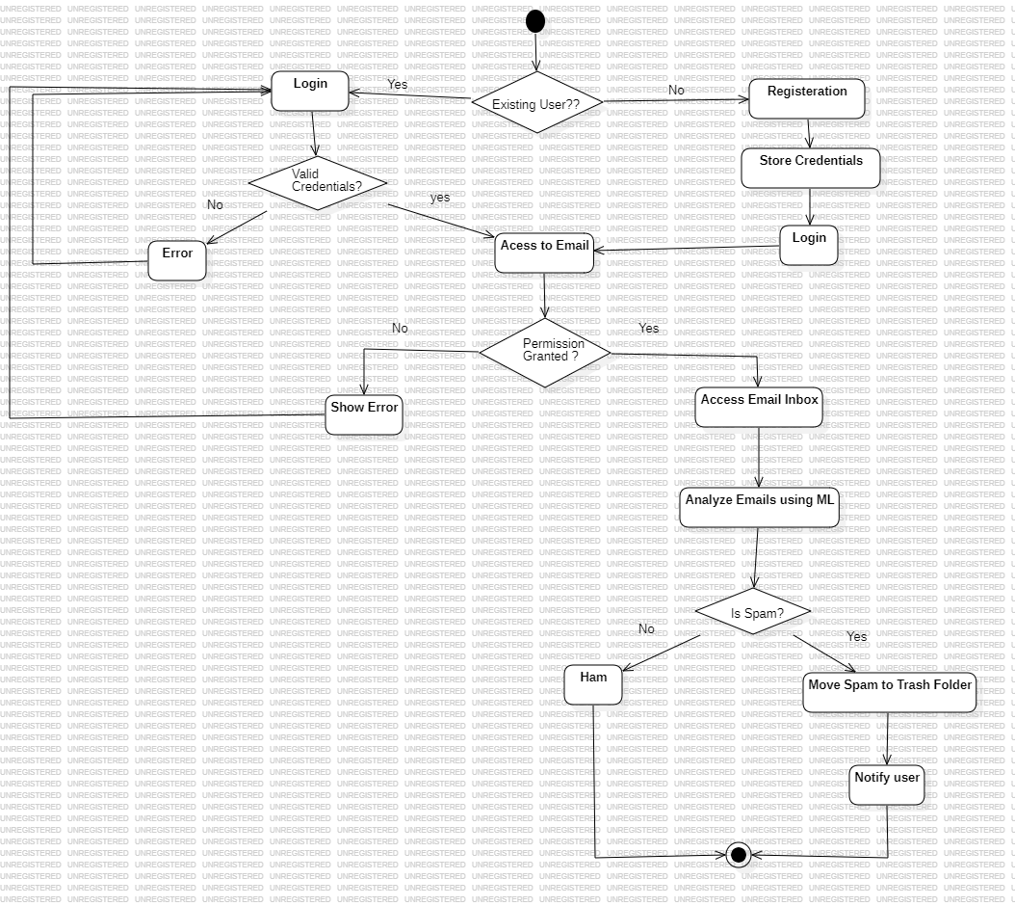
ACTIVITY DIAGRAM

Slide 16
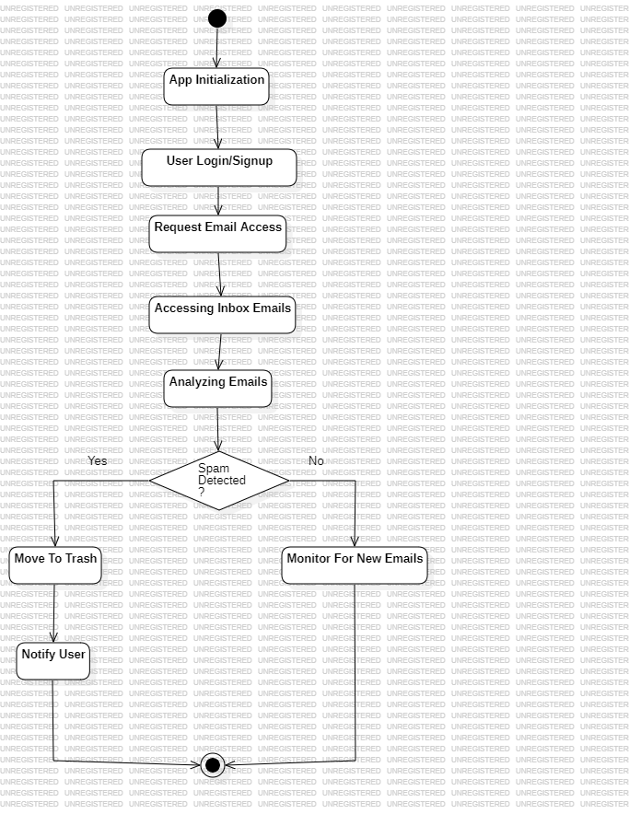
STATE DIAGRAM

Slide 17
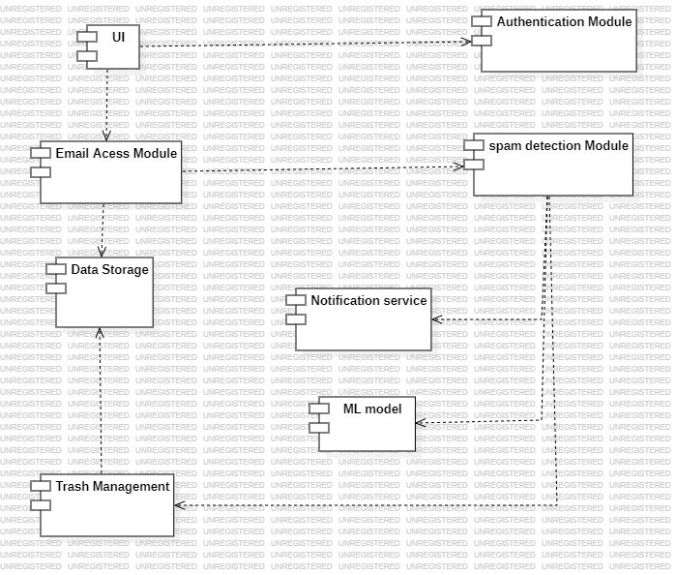
COMPONENT DIAGRAM

Slide 18
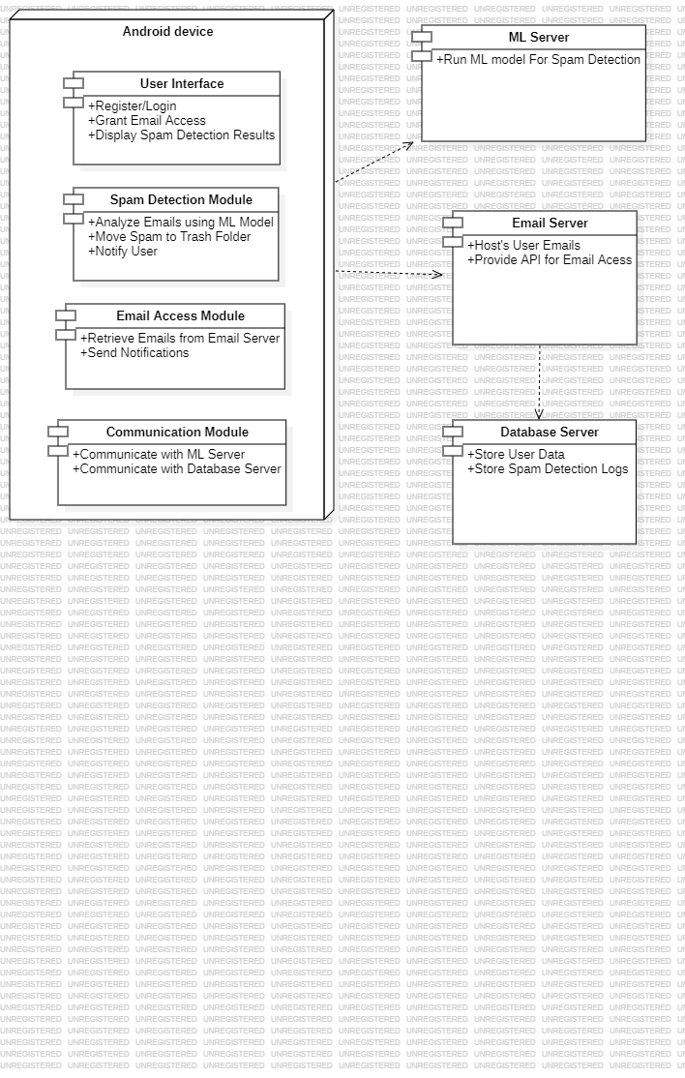
DEPLOYEMENT DIAGRAM

Slide 19
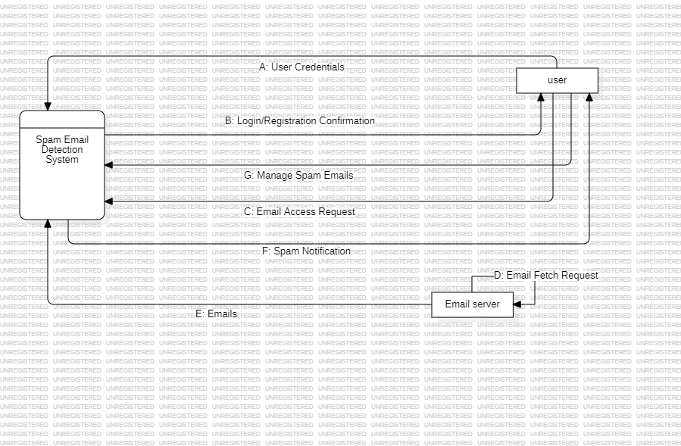
DATA FLOW DIAGRAM-LEVEL 0

Slide 20
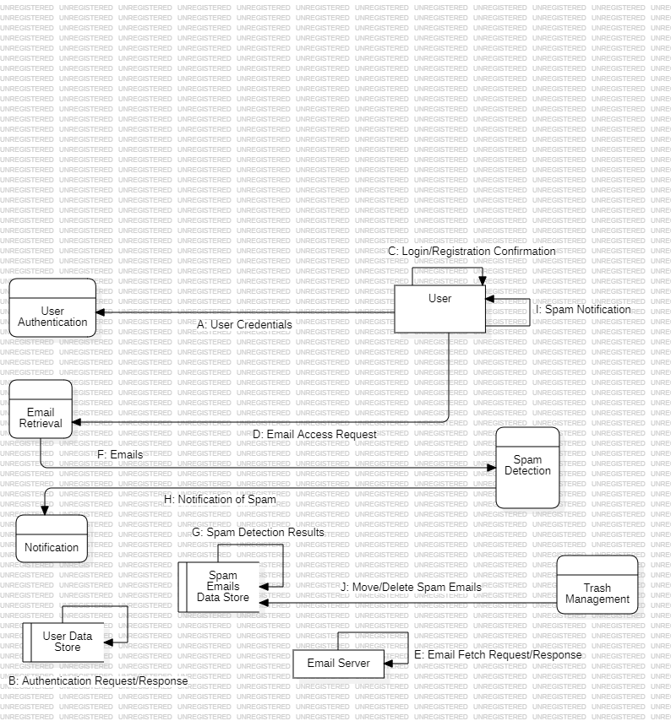
DATA FLOW DIAGRAM - LEVEL1

Slide 21
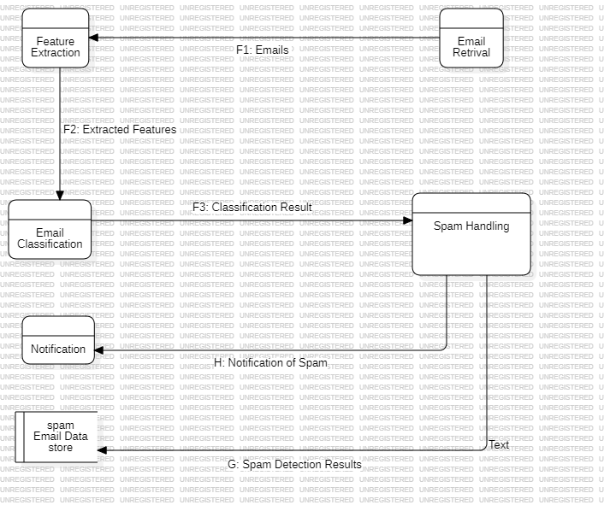
DATA FLOW DIAGRAM - LEVEL 2

Slide 22
COCOMO MODEL
For a organic project, the constants are:
a = 2.4, b = 1.05, c = 2.5, d = 0.38
Step 1: Define the KLOC project consists of 1000 lines of code (KLOC = 1).
Step 2: Effort Calculation
Effort=a×(KLOC) ^{b} Effort=2.4×(1) ^{1.05}=2.4 person-months
Step 3: Time to Develop (TDEV)
TDEV=c×(Effort)^{d} TDEV=2.5×(3.0) ^{0.38}=3.37 months
Results:
Effort: Approximately 2.4 person-months.
Development Time (TDEV): Approximately 3.37 months.

